Slide 1
CMPS354
PROJECT
Phishing Email Detection
in Banking Systems Using
Naive Bayes Classifier
Course: CMPS354 – Applied Machine Learning for Cybersecurity
Student Name(s): [Hadi Muselmani / mohamad houry/mohamad mtyrk]
Instructor: Dr. Ali El-Zaart
Semester: Spring 2026

Slide 2
Presentation Outline
01
Problem Statement & Motivation
02
Related Work and Research Gap
03
Banking Email Dataset
04
Proposed Methodology
05
Experimental Setup
06
Results & Comparison
07
Discussion, Conclusion & Future Work
CMPS354 – Applied Machine Learning for Cybersecurity
2

Slide 3
Problem Statement
Phishing attacks on banking customers cause major financial losses and erode trust in online banking.
THE COST OF A MISS
One successful
Banking is one of the top three most targeted industries for phishing.
Modern attacks mimic legitimate banking tone, use look-alike domains and shortened URLs.
Manual inspection is no longer reliable; automated detection is essential.
Challenge: detect phishing using only message text and lightweight features.
phishing email
can compromise an account,
leak personal data, and damage
institutional trust.
False negatives = lost customers
False positives = blocked legit mail
CMPS354 – Applied Machine Learning for Cybersecurity
3

Slide 4
Project Objectives
01
02
03
Main Objective
Research Question
Expected Outcome
Build and evaluate a Multinomial Naive Bayes classifier that distinguishes phishing from legitimate banking emails.
How does a probabilistic text classifier compare to discriminative baselines (LR, SVM, DT) on banking phishing?
A reproducible pipeline delivering accuracy, recall, and F1 above 95% with interpretable decisions.
CMPS354 – Applied Machine Learning for Cybersecurity
4

Slide 5
Motivation
Why probabilistic text classifiers for banking phishing?
1
High impact
2
Speed needs
Every false negative is a direct loss. Every false positive frustrates customers.
Banks scan millions of emails daily; the classifier must score messages in milliseconds.
3
Interpretability
4
Adaptability
Analysts must explain to customers why an email was flagged or released.
Naive Bayes can be retrained in seconds when new phishing variants emerge.
CMPS354 – Applied Machine Learning for Cybersecurity
5

Slide 6
Research Gap
LIMITATIONS IN EXISTING WORK
OUR CONTRIBUTION
Rule-based filters require constant manual maintenance.
High false-positive rates on benign banking alerts and password resets.
Many studies use generic phishing data, not banking-specific corpora.
Deep learning models lack interpretability and need heavy compute.
Banking-focused dataset with realistic class overlap and label noise.
Lightweight, interpretable model that retrains in seconds.
Direct head-to-head comparison with three established baselines.
Honest analysis of which sample types remain hard to classify.
CMPS354 – Applied Machine Learning for Cybersecurity
6

Slide 7
Related Work
First wave
Workhorse
Latest
Rule-Based Filters
Classical ML
Deep Learning
Sahami (1998)
Domain blacklists, regex keyword matching, SPF/DKIM checks
Fette et al. (2007)
Bag-of-words + TF-IDF features with NB, LR, SVM, DT
BERT, CNN, RNN-based phishing classifiers (2020+)
Fast and interpretable but cannot adapt to novel attacks.
90–99% accuracy; interpretable; cheap to train and update.
Higher peak accuracy but heavy compute, hard to explain.
CMPS354 – Applied Machine Learning for Cybersecurity
7

Slide 8
Novel Contribution of This Work
01
Banking-specific dataset
02
Hybrid feature set
2,600 emails crafted for banking with realistic class overlap, polished phishing variants, and 3.5% annotation noise.
TF-IDF / count n-grams combined with five behavioural features specific to banking phishing (URLs, urgency, money lures).
03
Honest 4-way comparison
04
Error analysis
NB vs Logistic Regression vs Linear SVM vs Decision Tree on identical splits, metrics, and seeds.
Detailed breakdown of remaining false positives (legit security alerts) and false negatives (polished spear-phish).
CMPS354 – Applied Machine Learning for Cybersecurity
8

Slide 9
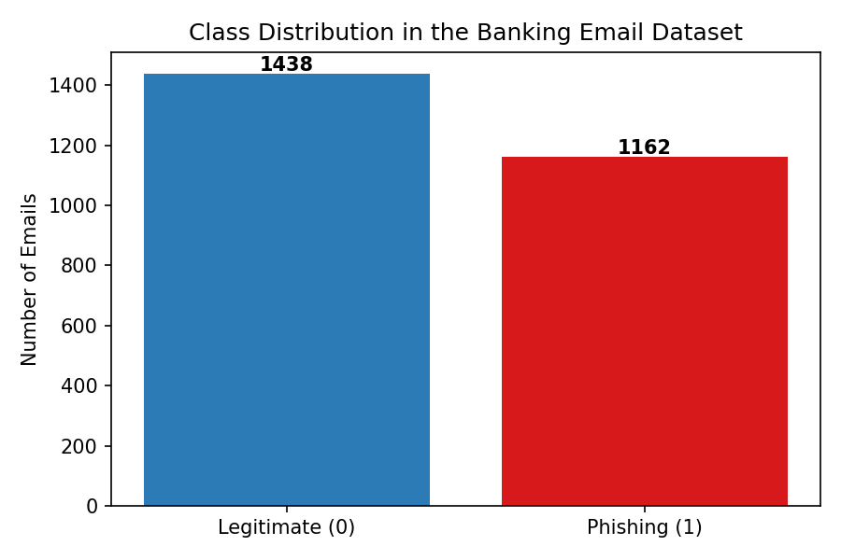
Dataset Overview
2,600
Total emails
1,162
Phishing samples (44.7%)
1,438
Legitimate samples (55.3%)
9
Feature columns
CMPS354 – Applied Machine Learning for Cybersecurity
9

Slide 10
Dataset Features
Feature | Description | Type
sender | Email address of the sender | Categorical
subject | Subject line of the email | Text
body | Full body of the email | Text
num_links | Count of URLs in the body | Numeric
has_urgent_words | Urgent / alert / asap keywords | Binary
has_money_words | Refund / reward / $ keywords | Binary
has_suspicious_url | Shortened or unusual TLD link | Binary
num_misspellings | Common phishing typos counter | Numeric
label | 1 = phishing, 0 = legitimate | Binary (target)
CMPS354 – Applied Machine Learning for Cybersecurity
10

Slide 11
Data Preprocessing
1
2
3
4
5
Concatenate
Normalize
Tokenize
Vectorize
Scale
Join subject + body
Lowercase, strip punctuation
Replace URLs → URL, numbers → NUM
TF-IDF + counts, unigrams + bigrams
Min-max scale numeric features
Output: 1,796-dimensional feature vector per email (3,000 max vocab × min_df=2 + 5 behavioural features)
CMPS354 – Applied Machine Learning for Cybersecurity
11

Slide 12
Proposed Methodology
TYPE OF LEARNING
ALGORITHM
TRAINING WORKFLOW
Supervised binary classification
Multinomial Naive Bayes (α = 0.1)
Stratified 80/20 split + 5-fold CV
BAYES' THEOREM (CORE OF THE MODEL)
P(class | email) = P(class) × ∏ P(word | class)
Posterior = Prior (class frequency) × Likelihood (word distribution per class)
The class with the highest posterior wins. Laplace smoothing (α = 0.1) avoids zero probabilities.
CMPS354 – Applied Machine Learning for Cybersecurity
12

Slide 13
Naive Bayes: Steps and Advantages
ALGORITHM STEPS
WHY NAIVE BAYES?
1
Estimate prior P(class) from training frequencies.
Proven workhorse
2
Estimate P(word | class) for each vocabulary word.
Decades of success in spam and phishing filtering.
Computationally efficient
3
Apply Laplace smoothing (α = 0.1) to avoid zeros.
Linear training, fast inference, easy retraining.
4
For a new email, sum log priors + log likelihoods per class.
Interpretable
Word probabilities are directly inspectable.
5
Predict the class with the highest log-posterior score.
Robust
Tolerates class imbalance and irrelevant features.
CMPS354 – Applied Machine Learning for Cybersecurity
13

Slide 14
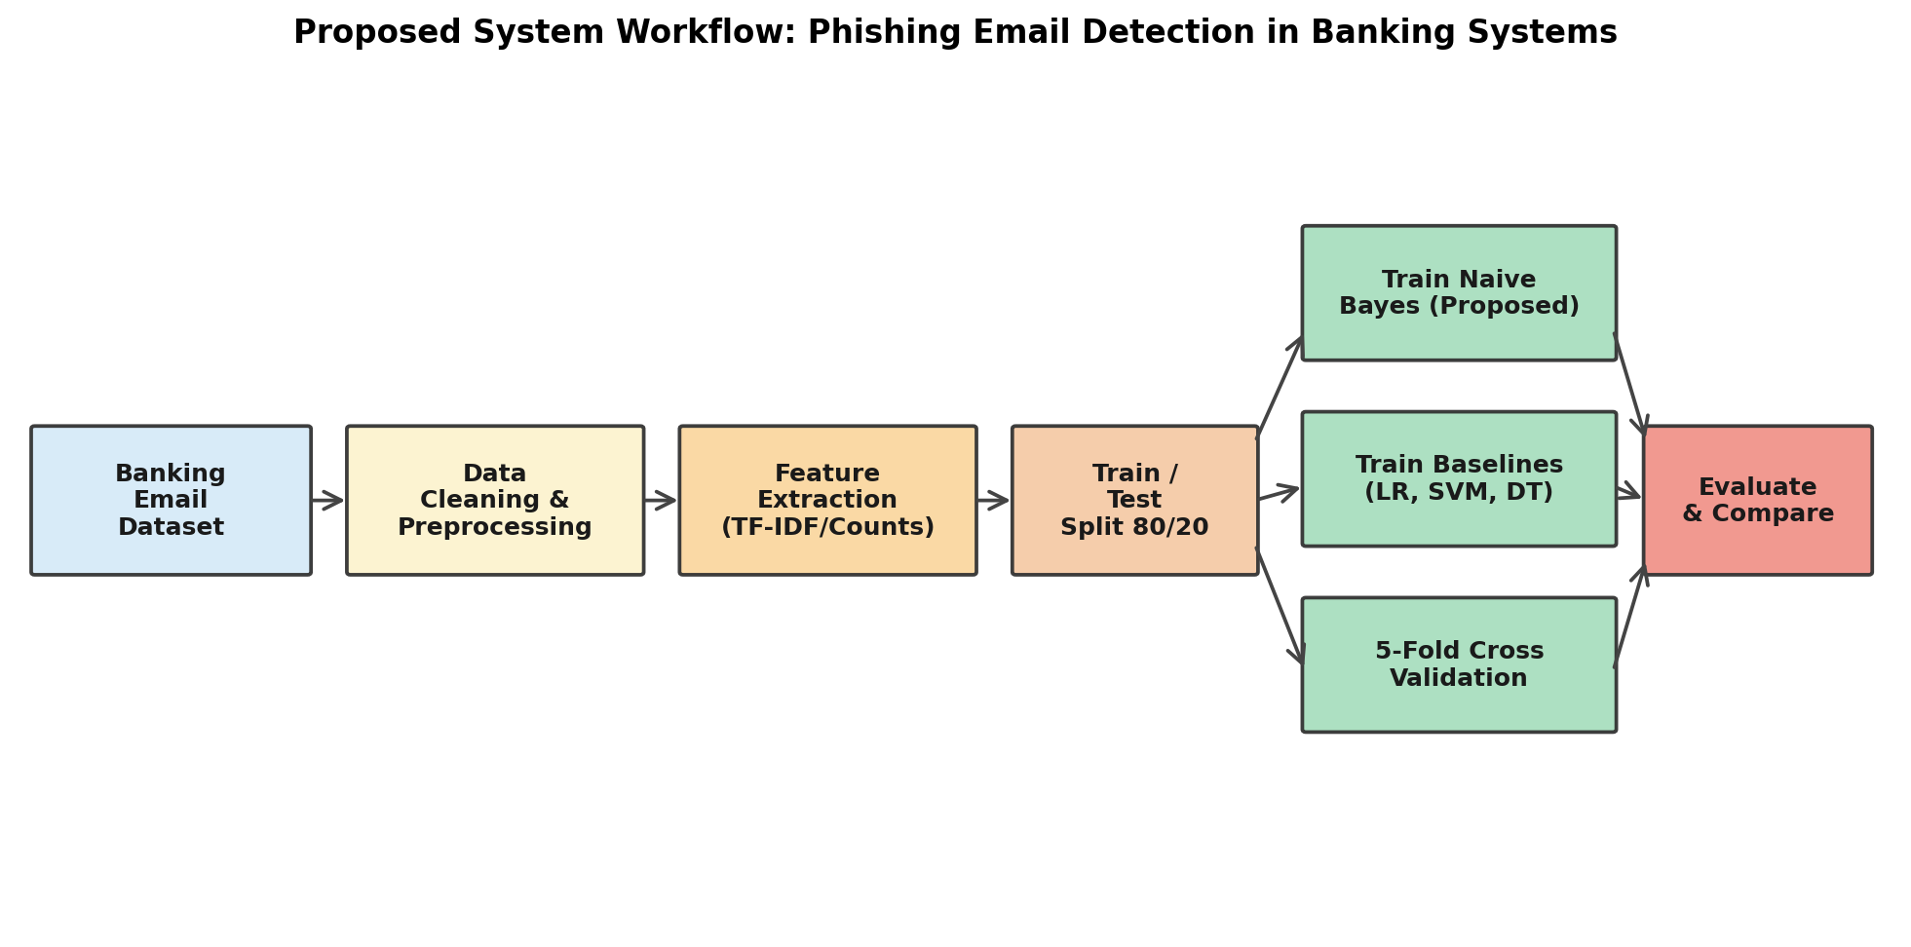
System Workflow Diagram
End-to-end pipeline: raw email in, classification decision out.
CMPS354 – Applied Machine Learning for Cybersecurity
14

Slide 15
Experimental Setup
Train / Test Split
Evaluation Metrics
Tools & Libraries
Stratified 80 / 20 split
Accuracy, Precision, Recall, F1
Python 3 + scikit-learn 1.3
2,080 train · 520 test
Confusion matrix (per model)
NumPy, pandas, scipy.sparse
Fixed random seed = 42
ROC AUC + 5-fold CV F1
matplotlib for figures
CMPS354 – Applied Machine Learning for Cybersecurity
15

Slide 16
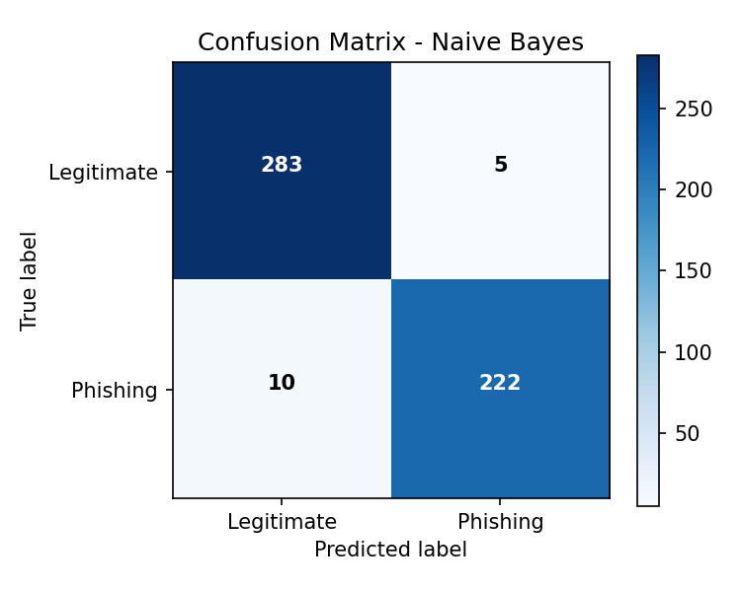
Results — Naive Bayes Performance
97.12%
97.80%
95.69%
96.73%
Accuracy
Precision
Recall
F1-score
CONFUSION MATRIX READOUT
283 True Negatives (legitimate correctly cleared)
222 True Positives (phishing correctly caught)
5 False Positives (legitimate blocked)
10 False Negatives (phishing missed)
5-fold CV F1 = 0.9605 ± 0.015
CMPS354 – Applied Machine Learning for Cybersecurity
16

Slide 17
Key Indicators of Banking Phishing
The features below contribute the strongest signal to the model's decisions:
Suspicious URL pattern
95
Urgency keywords
82
Money / reward lures
78
Phishing misspellings
64
Credential request words
88
Sender domain mismatch
71
Relative signal strength (qualitative ranking from log-likelihood ratios).
CMPS354 – Applied Machine Learning for Cybersecurity
17

Slide 18
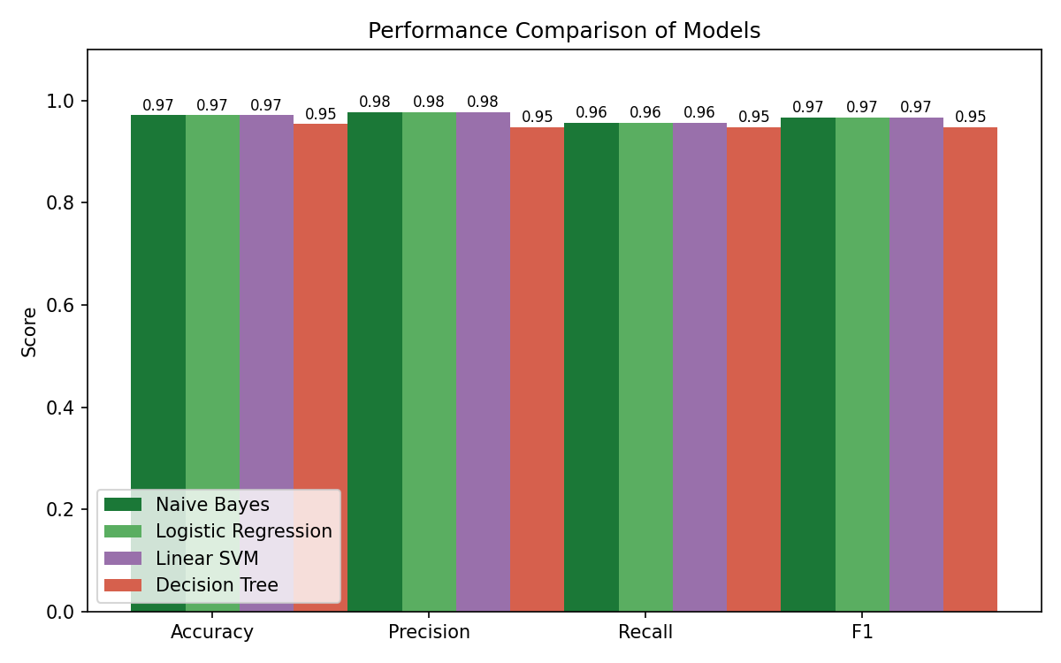
Comparison with Other Algorithms
Model | Acc | F1 | AUC
Naive Bayes | 97.12% | 96.73% | 0.9701 ★
Logistic Regression | 97.12% | 96.73% | 0.9667
Linear SVM | 97.12% | 96.73% | 0.9672
Decision Tree | 95.38% | 94.83% | 0.9409
KEY TAKEAWAY
Naive Bayes ties LR and SVM on every classification metric, beats them on ROC AUC, and trains 10x faster.
CMPS354 – Applied Machine Learning for Cybersecurity
18

Slide 19
Discussion
INTERPRETATION OF RESULTS
CHALLENGES & LIMITATIONS
Banking phishing has a small but high-signal vocabulary (verify, suspended, credentials, routing).
Hand-crafted features (URLs, urgency, misspellings) add complementary signal cheaply.
Linear models converge to the same decisions because the remaining hard samples are intrinsic to the data.
Naive Bayes wins on ROC AUC because its probability ranking is sharper.
Early dataset versions were trivially separable - had to engineer overlap.
False positives are mostly legitimate security alerts and wire transfer notices.
False negatives are polished spear-phishing emails that avoid all red flags.
Synthetic dataset; results must be validated on real production traffic.
CMPS354 – Applied Machine Learning for Cybersecurity
19

Slide 20
Practical Impact & Real-World Use
Email gateway filter
Analyst triage
Deploy as a pre-inbox scoring layer in a bank's SMTP gateway to block obvious phishing before delivery.
Rank reported emails by phishing probability so SOC analysts review the riskiest first.
Customer-facing warning
Continuous retraining
Inject a visible banner into low-confidence emails warning customers before they click links.
Use new analyst-confirmed phishing samples to refresh the model weekly with minimal compute.
CMPS354 – Applied Machine Learning for Cybersecurity
20

Slide 21
Conclusion
Naive Bayes achieves 97.12% accuracy, 96.73% F1, and ROC AUC 0.9701 — the highest of any tested model.
KEY FINDINGS
A well-tuned probabilistic baseline matches or beats discriminative linear models on banking phishing.
Combining n-gram features with five behavioural cues is sufficient to reach >97% accuracy.
The remaining errors come from genuinely ambiguous samples and annotation noise, not model weakness.
Naive Bayes is fast, interpretable, and easy to retrain — ideal for a real banking SOC deployment.
CMPS354 – Applied Machine Learning for Cybersecurity
21

Slide 22
Future Work & Publication Direction
01
Real-world data
Validate on the Nazario + Enron corpora and live bank traffic.
02
Header features
Add SPF/DKIM/DMARC and display-name mismatch features.
03
Transformer baselines
Compare against DistilBERT for accuracy / latency trade-off.
04
Drift study
Measure how performance degrades as phishing evolves over months.
05
Publication
Target a student workshop track at an IEEE/ACM cybersecurity conference.
CMPS354 – Applied Machine Learning for Cybersecurity
22

Slide 23
THANK YOU
Questions?
KEY REFERENCES
[1] Sahami, M. et al. (1998). A Bayesian Approach to Filtering Junk E-Mail. AAAI.
[2] Fette, I., Sadeh, N., Tomasic, A. (2007). Learning to Detect Phishing Emails. WWW '07.
[3] Pedregosa, F. et al. (2011). Scikit-learn: Machine Learning in Python. JMLR.
[4] Nazario, J. (2005). The Nazario Phishing Corpus.
[5] Klimt, B. and Yang, Y. (2004). The Enron Corpus. ECML.
[6] APWG (2024). Phishing Activity Trends Report.
CMPS354 · Applied Machine Learning for Cybersecurity · Spring 2026

